Slide 1

How to Choose A Great Red Wine

Slide 2

Phoebe
Previously a Family and Consumer Sciences teacher
Interested in data analysis for the change in career path and many opportunities !

Slide 3
Tanishia

Slide 4
Project Introduction

Slide 5
You should have a couple slides of background information about the topic you are covering. For instance, if you are asking and answering questions about the stock market, you should give a little basic information about the stock market. Try to build this up, so start with the most general information and then get more specific with information that directly relates to your data or the questions you will be answering with the data.

Slide 6

Background on red wine
Why people love drinking it
Where are the most popular places for red wine?
Why are certain regions better than others?
What does the environment have to do with the production of red wine?

Slide 7
Question 1 : What Factors Determine a Quality Wine ?
Why we chose this question
The variables that went into it

Slide 8
Question 2: Which factor has the most impact on the alcohol percentage in wine ?
Why we chose this question
The variables that went into it

Slide 9
Methods

Slide 10
Next comes your methods section. This is where you talk about all of the details regarding your data. You want to give a very high level overview of what you did to:
Gather/find data
Manipulate / wrangle data
Create new variables
You also want to paint a picture of what your data is like. Include details such as:
Important variables and their summary statistics
Sample size
The methods section should only be a few slides, and should not include any code. You are presenting to a wide, non-data science audience, and thus should not go into a lot of detail.

Slide 11
Question 1 : What Factors Determine a Quality Wine ?
Chi Square Test
Stepwise Regression
(Show code )

Slide 12
Question 2: Which factor has the most impact on the alcohol percentage in wine ?
Stepwise Regression
(Show Code )

Slide 13
Results From Tests

Slide 14
Question 1 : What Factors Determine a Quality Wine ?
Initial results just from the tests run
Stepwise Regression Results - the variables that impact the quality of the wine is : free sulfur dioxide , pH, total sulfur dioxide, chlorides, sulphates, volatile acidity, and alcohol content

Slide 15
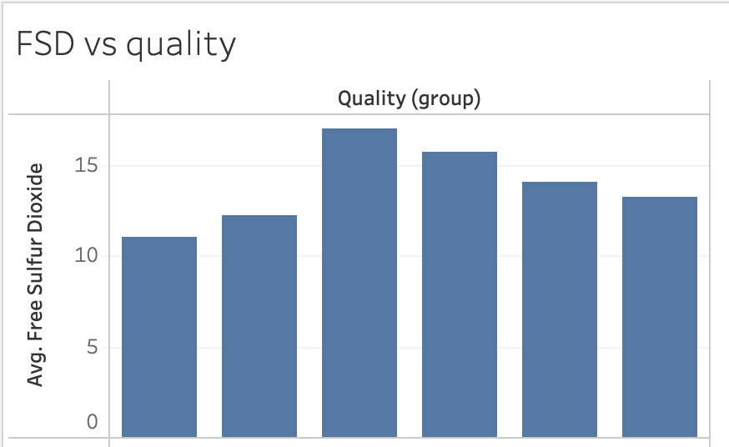
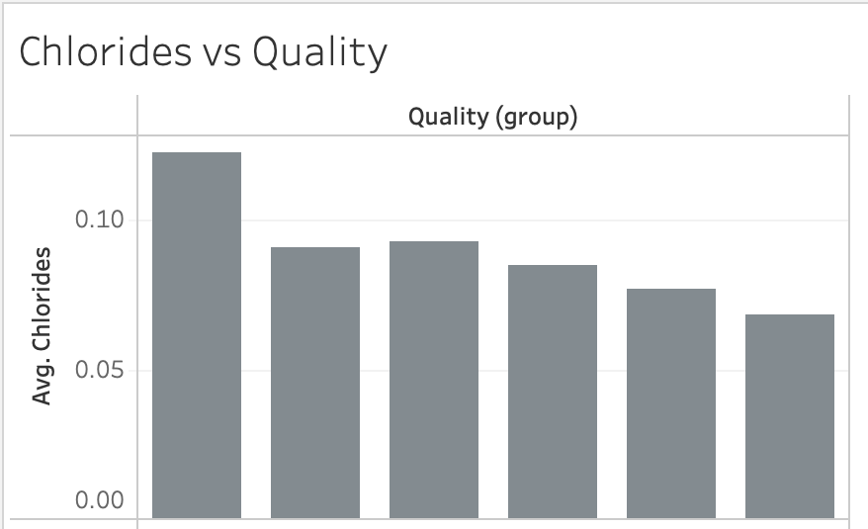
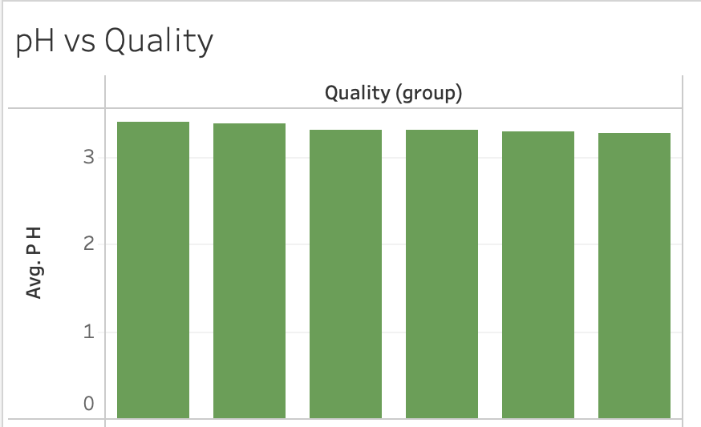
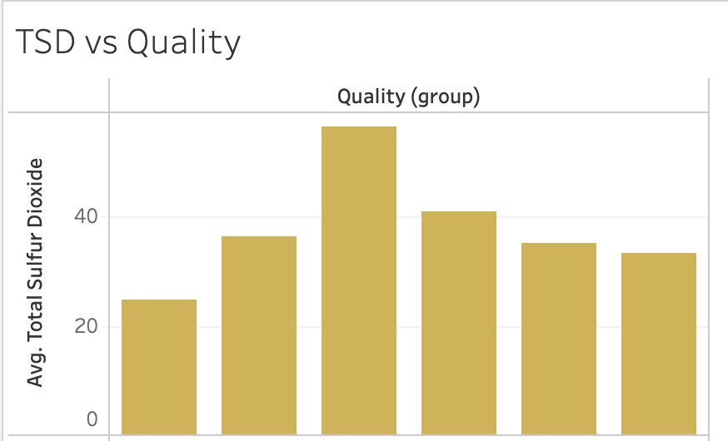
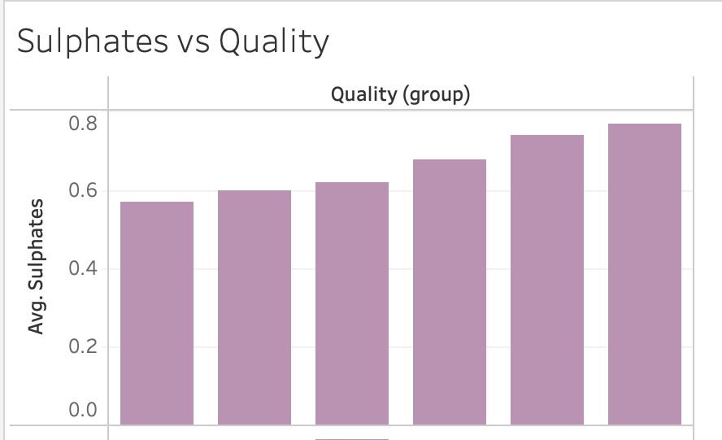
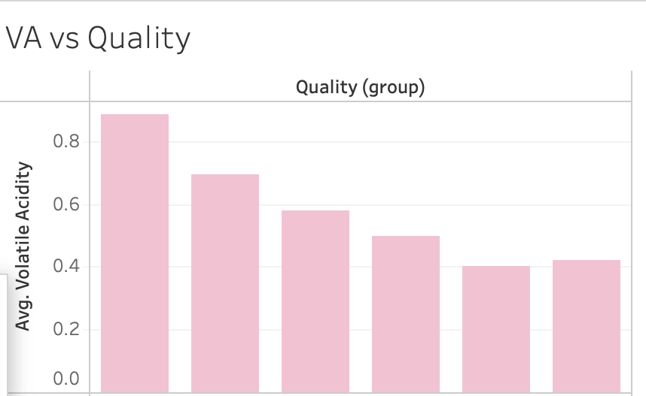
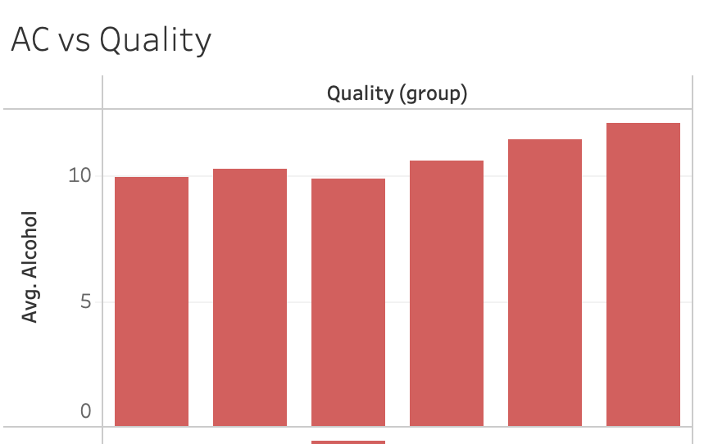
Question 1 : What Factors Determine a Quality Wine ?
free sulfur dioxide
pH
total sulfur dioxide
Chlorides
Sulphates
volatile acidity
alcohol content

Slide 16
Question 2: Which factor has the most impact on the alcohol percentage in wine ?
Initial results just from the tests run
Stepwise Regression Results - all of the variables have a direct impact except for free sulfur dioxide.

Slide 17
Question 2: Which factor has the most impact on the alcohol percentage in wine ?

Slide 18
Summary

Slide 19
The summary should be JUST ONE SLIDE, and it should contain a summary of the entirety of your results section. It should be in layman's terms, quick and dirty.

Slide 20
Conclusion

Slide 21
Your conclusion section should also only be one slide long. In it, you should have some bullet points containing information about: How do your findings impact the world at large? What's important about this work? Big picture information

Slide 22
Questions?

